Slide 1
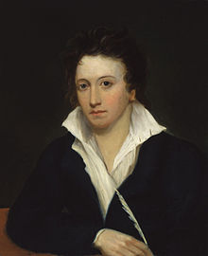
Percy Bysshe Shelley (1792 - 1822)

Slide 2
One word is too often profaned
For me to profane it,
One feeling too falsely disdain'd
For thee to disdain it.
One hope is too like despair
For prudence to smother,
And pity from thee more dear
Than that from another.
I can give not what men call love;
But wilt thou accept not
The worship the heart lifts above
And the Heavens reject not:
The desire of the moth for the star,
Of the night for the morrow,
The devotion to something afar
From the sphere of our sorrow?

Slide 3
Ozymandias
I met a traveller from an antique land
Who said: Two vast and trunkless legs of stone
Stand in the desert. Near them, on the sand,
Half sunk, a shattered visage lies, whose frown,
And wrinkled lip, and sneer of cold command,
Tell that its sculptor well those passions read
Which yet survive, stamped on these lifeless things,
The hand that mocked them and the heart that fed:
And on the pedestal these words appear:
"My name is Ozymandias, king of kings:
Look on my works, ye Mighty, and despair!"
Nothing beside remains. Round the decay
Of that colossal wreck, boundless and bare
The lone and level sands stretch far away.

